Slide 1
Sorting Algorithms
Selection,Radix,Shell,Merge,Quicksort

Slide 2
Introduction
Sorting Algorithms are an essential part of computer science and are used to arrange data in a particular order
There are various sorting algorithms available such as Selection Sort, Radix Sort, Shell Sort, Merge Sort, and Quicksort
In this presentation, we'll discuss each of these sorting algorithms and theirtime complexities

Slide 3
Radix Sort
Radix Sort is a non-comparative integer sorting algorithm that sorts data with integer keys by grouping digits that represent the same significant position
Time complexity: O(kn), where k is the number of digits in the largest number
Efficient for large datasets with fixed-length keys

Slide 4
Selection Sort
Selection Sort is a simple sorting algorithm that works by repeatedly finding the minimum element from the unsorted part of an array and placing it at the beginning
Time complexity: O(n^2)
Not recommended for large datasets

Slide 5
Shell Sort
Shell Sort is an extension of Insertion Sort and works by comparing elements that are far apart and gradually reducing the gap between them until they are adjacent
Time complexity: O(n^2)
Not recommended for large datasets
sd

Slide 6
Merge Sort
Merge Sort is a divide-and-conquer algorithm that divides an array into two halves, sorts each half, and then merges the sorted halves into a single sorted array
Time complexity: O(n log n)
Efficient for large datasets

Slide 7
Quicksort
Quicksort is another divide-and-conquer algorithm that works by selecting a pivot element and partitioning the other elements into two sub-arrays based on whether they are less than or greater than the pivot
Time complexity: O(n log n)
Efficient for large datasets
However, it may have a worst-case time complexity of O(n^2) if the pivot is chosen poorly

Slide 8
Comparison of Sorting Algorithms
The results have been achieved through the algorithm provided in the github repository.
Every test type has been runed 50 times than averaged for the visualization presented in the chart.

Slide 9
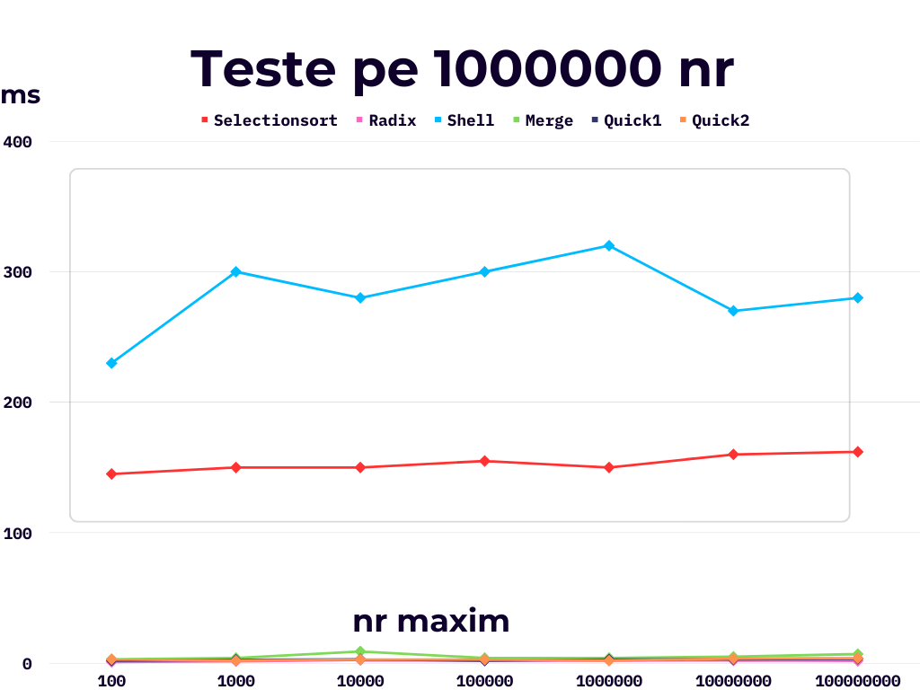
Comparison of Sorting Algorithms

Slide 10
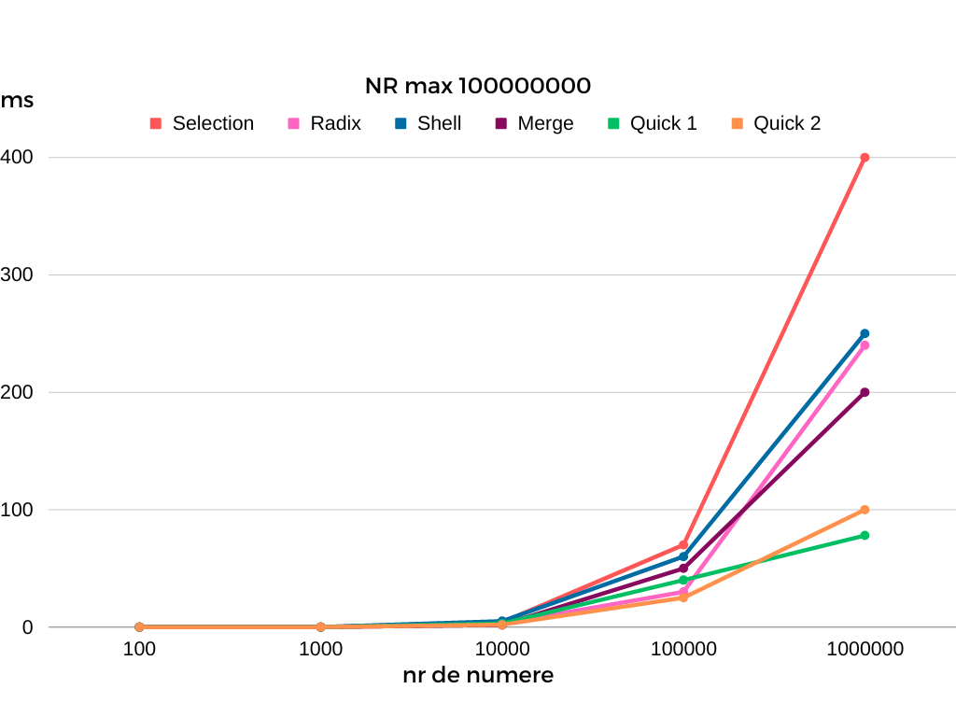
Comparison of Sorting Algorithms

